Slide 1
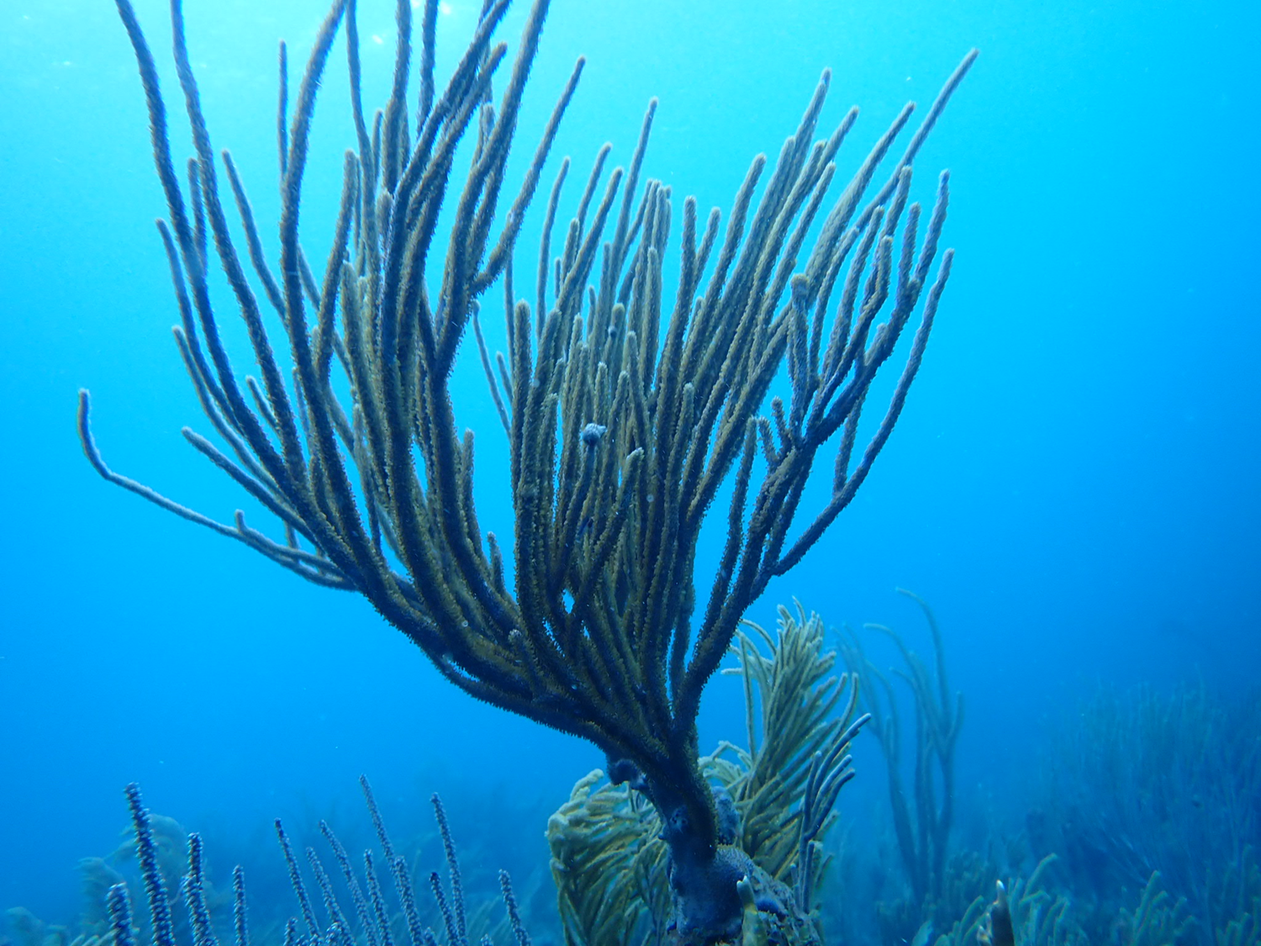
Effects of scale and substratum on octocoral recruitment
Kaitlyn Tonra – Analytical Workflows
Project Update

Slide 2

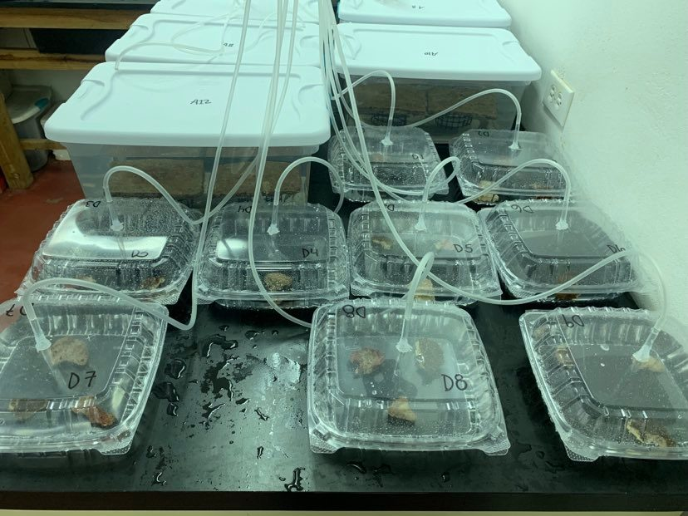
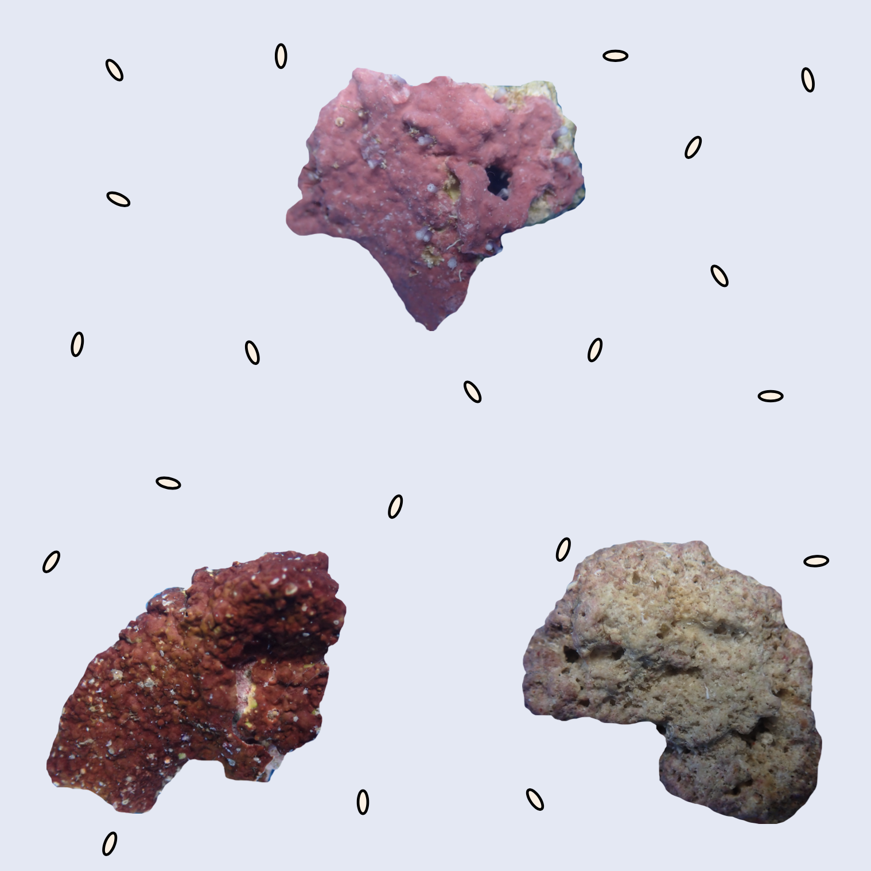
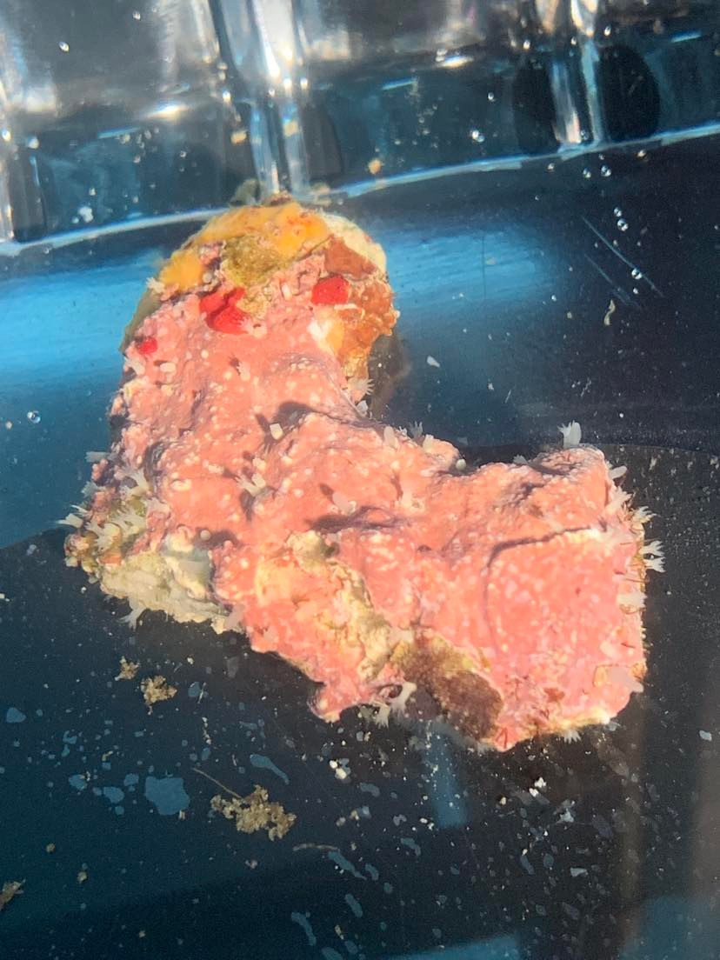
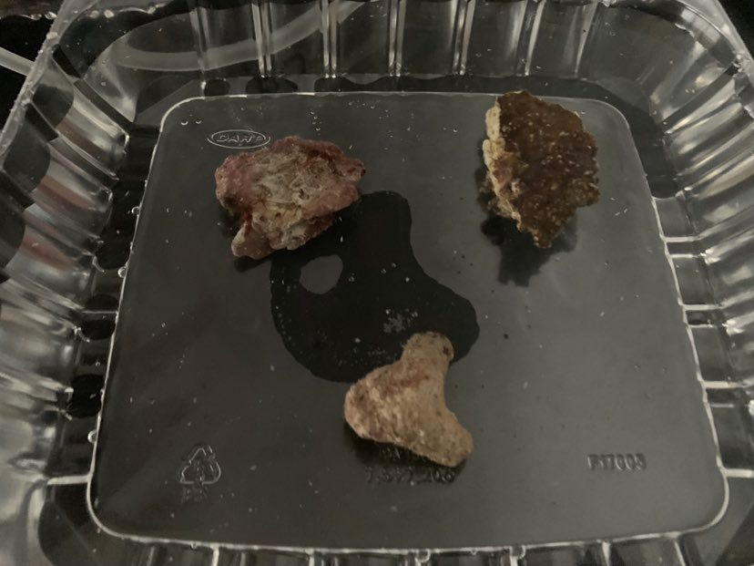
CCA
RAM
Patch types
BARE
Questions:
What spatial scales are important for decision making during the settlement phase of an octocoral’s life?
How do different species of algal crust influence settlement and survival?

Slide 3
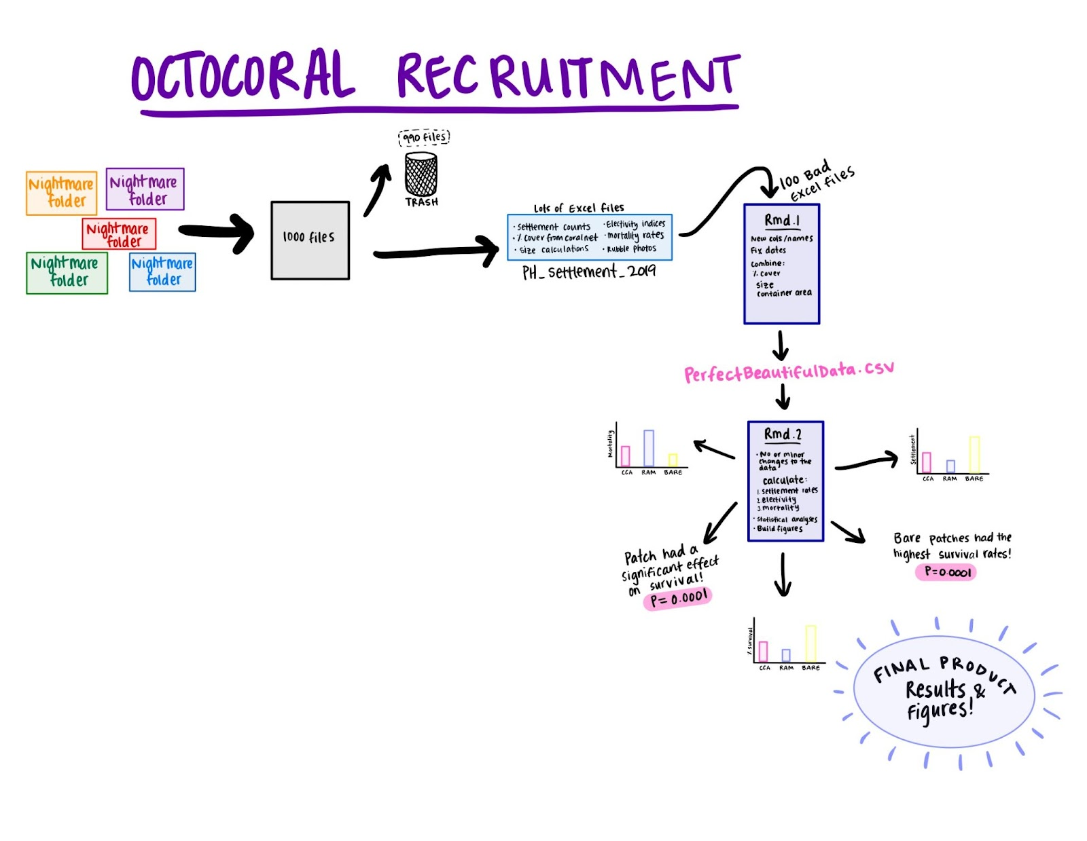
Goals from proposal and midterm update:
Arrange data in a reasonable way
Create a clear pipeline to figures
Redo all methods in R (prep, mortality, electivity, stats)
Create metadata & style guide file
Set up an Rmd (or something else?) that I’ll be able to understand and make changes to in 5 years

Slide 4

Goals from proposal and midterm update:
Arrange data in a reasonable way
Create a clear pipeline to figures
Redo all methods in R (prep, mortality, electivity, stats)
Create metadata & style guide file
Set up an Rmd (or something else?) that I’ll be able to understand and make changes to in 5 years

Slide 5
Goals from proposal and midterm update:
Arrange data in a reasonable way
Create a clear pipeline to figures
Redo all methods in R (prep, mortality, electivity, stats)
Create metadata & style guide file
Set up an Rmd (or something else?) that I’ll be able to understand and make changes to in 5 years

Slide 6
Goals from proposal and midterm update:
Arrange data in a reasonable way
Create a clear pipeline to figures
Redo all methods in R (prep, mortality, electivity, stats)
Create metadata & style guide file
Set up an Rmd (or something else?) that I’ll be able to understand and make changes to in 5 years

Slide 7
Goals from proposal and midterm update:
Arrange data in a reasonable way
Create a clear pipeline to figures
Redo all methods in R (prep, mortality, electivity, stats)
Create metadata & style guide file (in progress)
Set up an Rmd (or something else?) that I’ll be able to understand and make changes to in 5 years

Slide 8
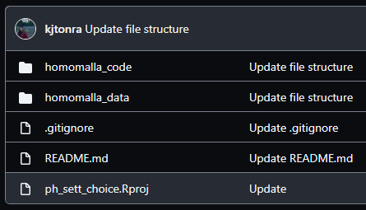
Goals from proposal and midterm update:
Arrange data in a reasonable way
Create a clear pipeline to figures
Redo all methods in R (prep, mortality, electivity, stats)
Create metadata & style guide file (in progress)
Set up an Rmd (or something else?) that I’ll be able to understand and make changes to in 5 years

Slide 9
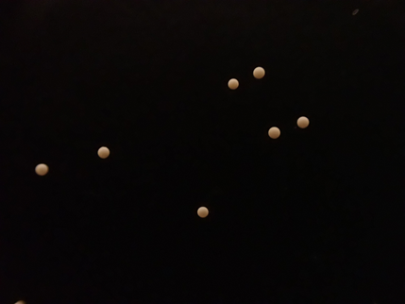
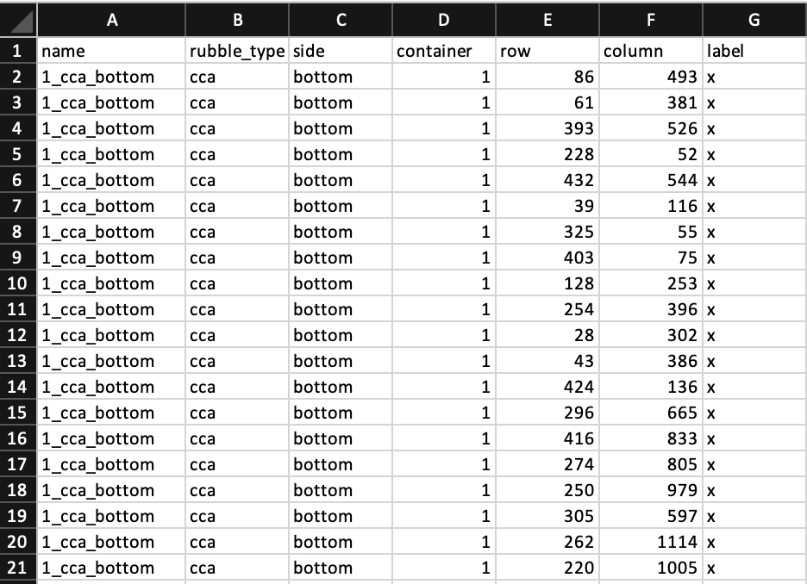
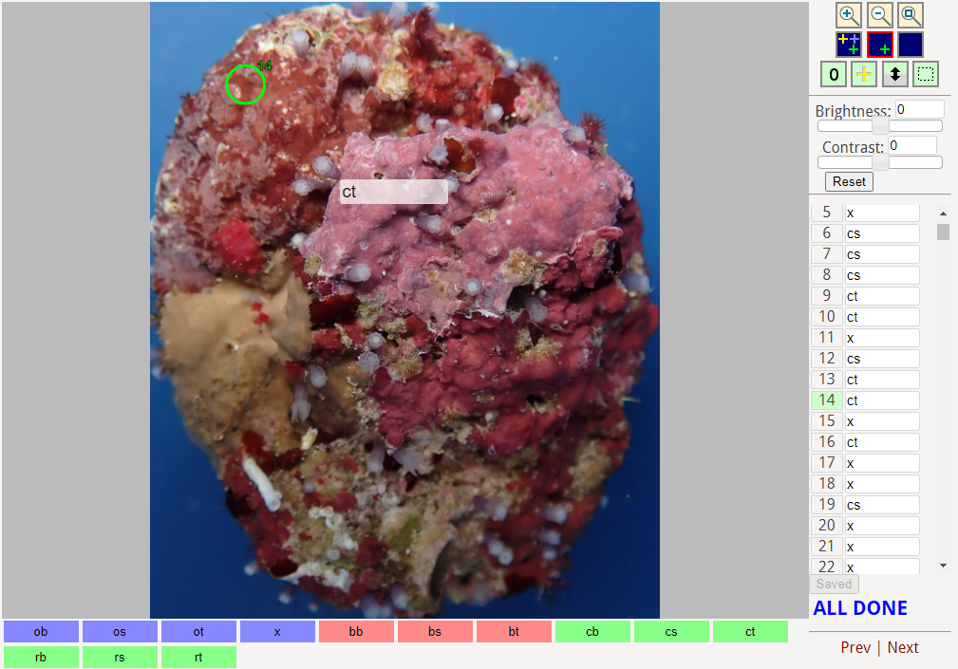
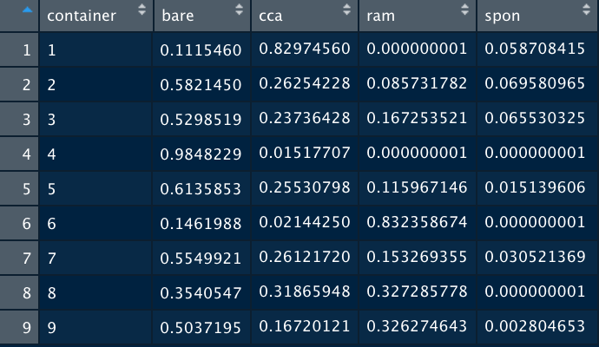
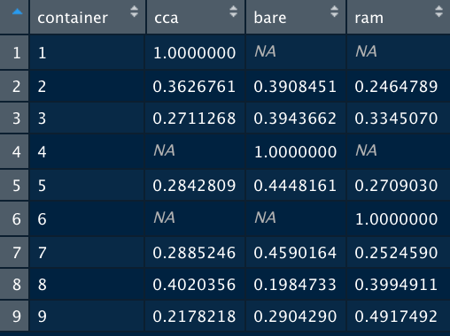
Part I: Annotations and areas
16,800
Annotations
Patch-level analyses
Rubble-level analyses
Surface area calculations
Proportion of each rubble covered with each substratum type
Proportion of each container

Slide 10
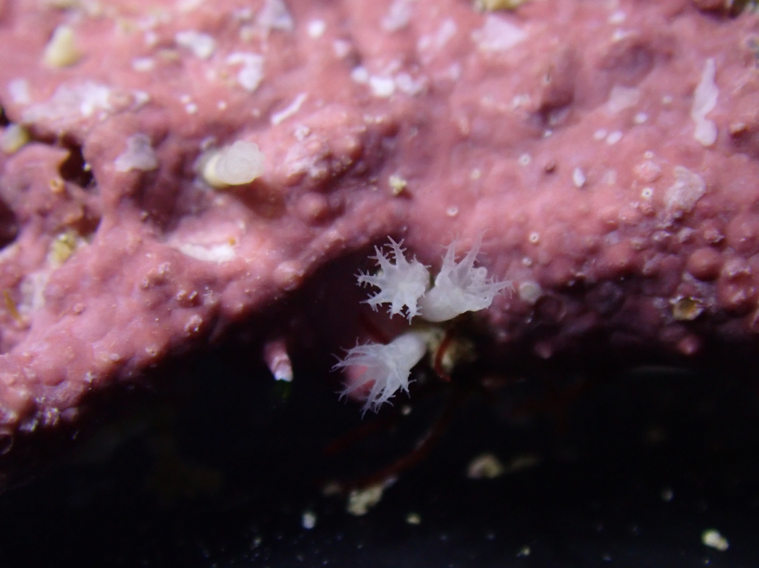
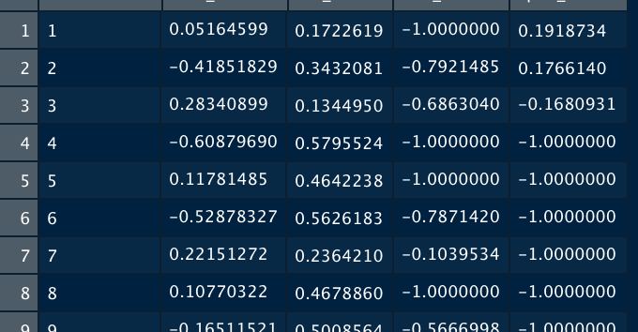
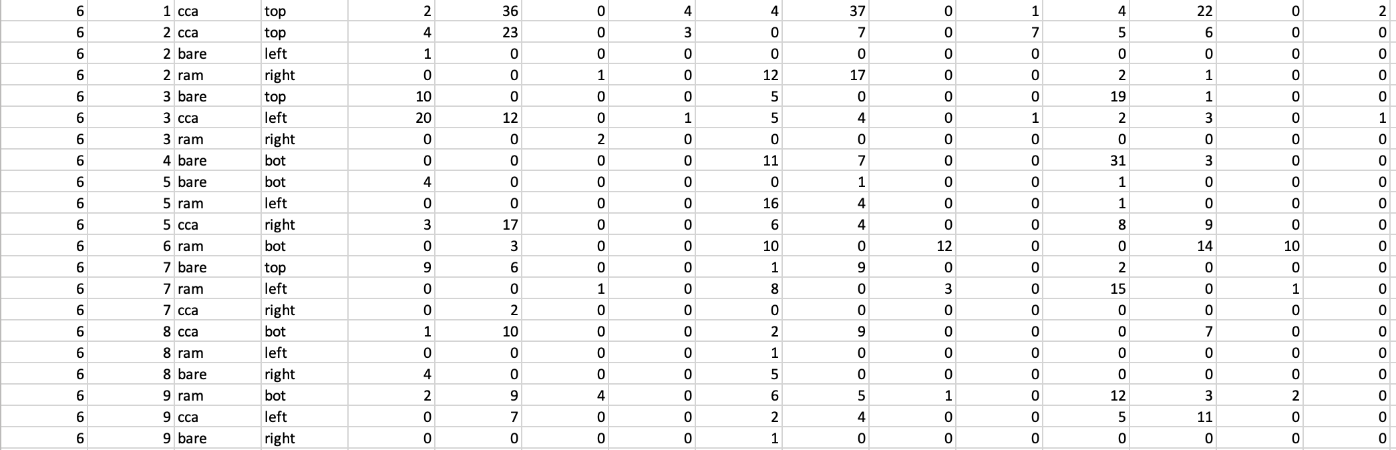
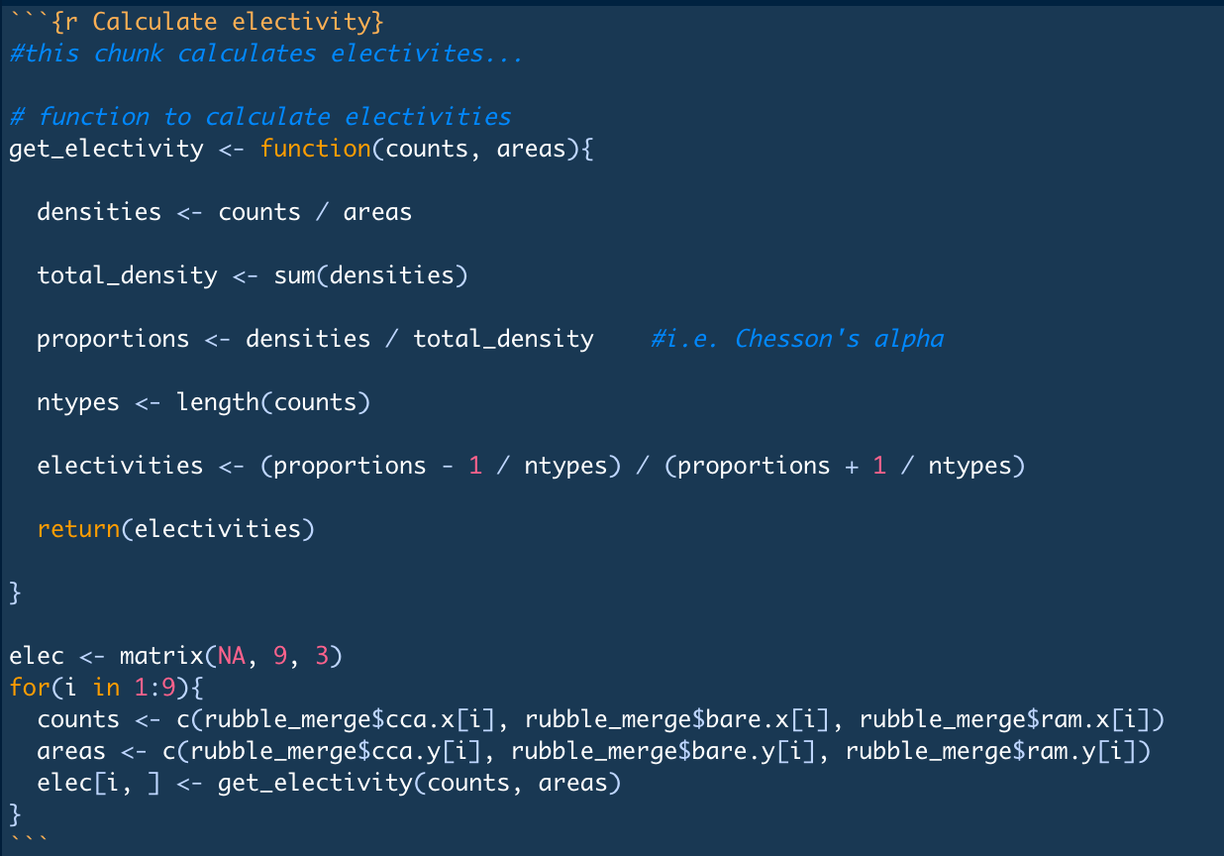
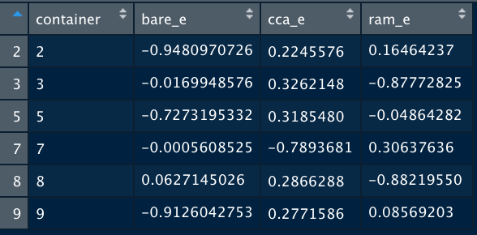
Part II: Electivity (and mortality)
Vanderploeg and Scavia’s (1979) Electivity Index:
Range of values from -1 to 1, used to quantify avoidance and preference behaviors
Inputs:
Settlement counts, total areas, and proportions of different substratum types.
Results:
An electivity score (E*, -1, 1) for every resource of interest.

Slide 11
Part III: Stats and figures (in progress)
Statistical Analyses
Figures
PERMANOVA using vegan package
E* can’t easily be used with parametric tests
My results may have changed here from what I expected / found previously
This part is still in progress! I have functional code, but it isn’t yet integrated into the main R scripts.

Slide 12
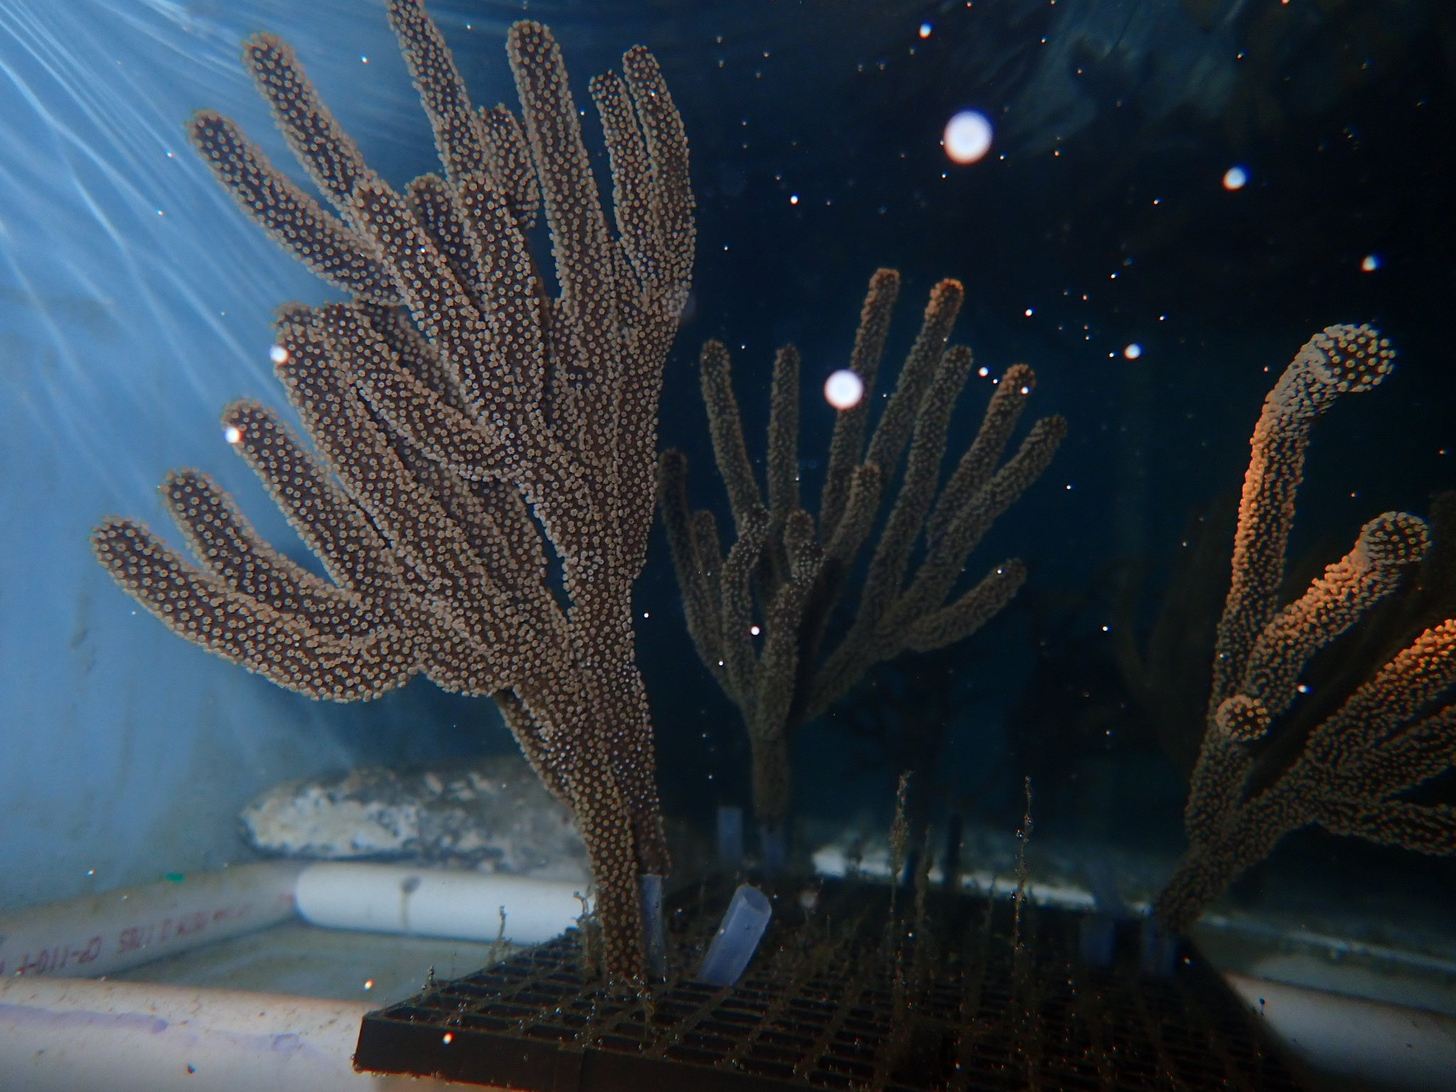
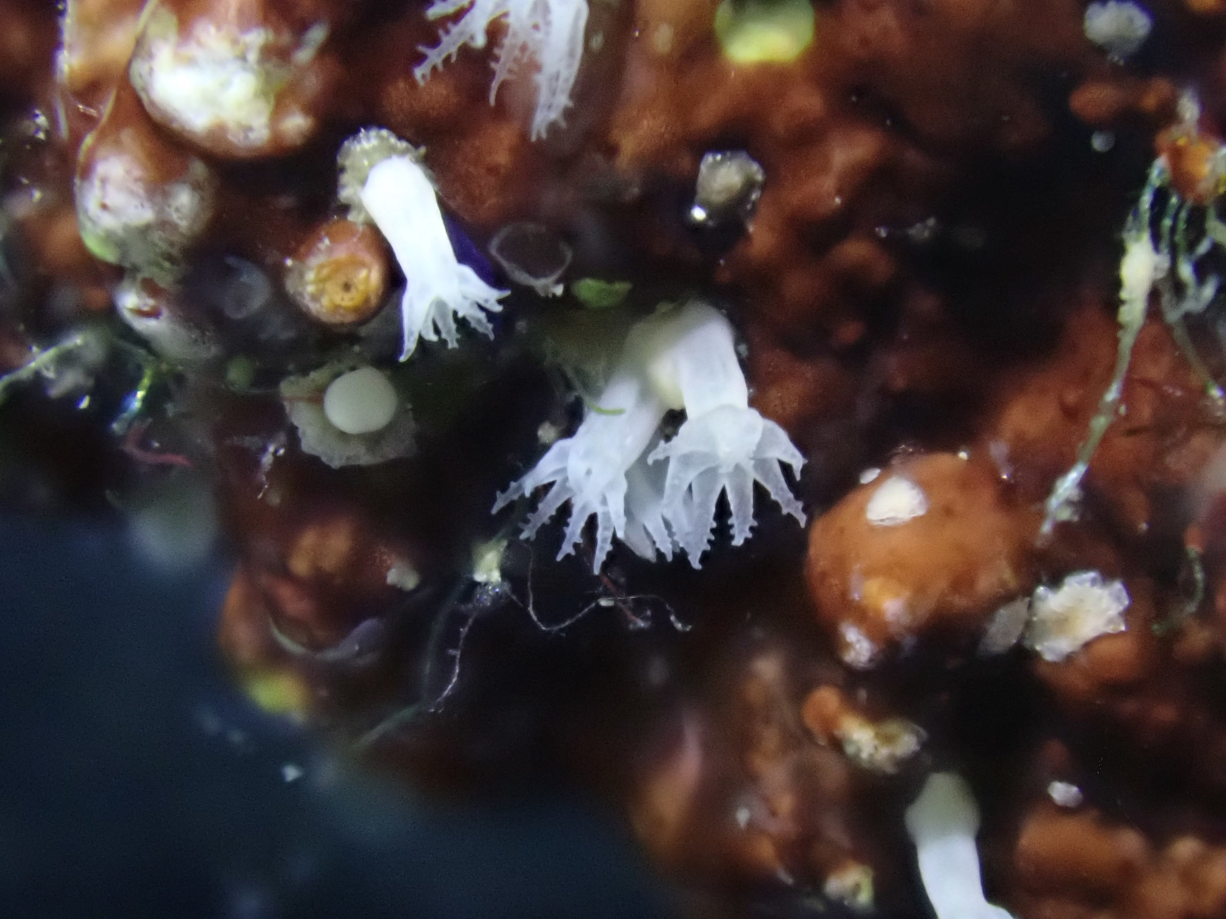
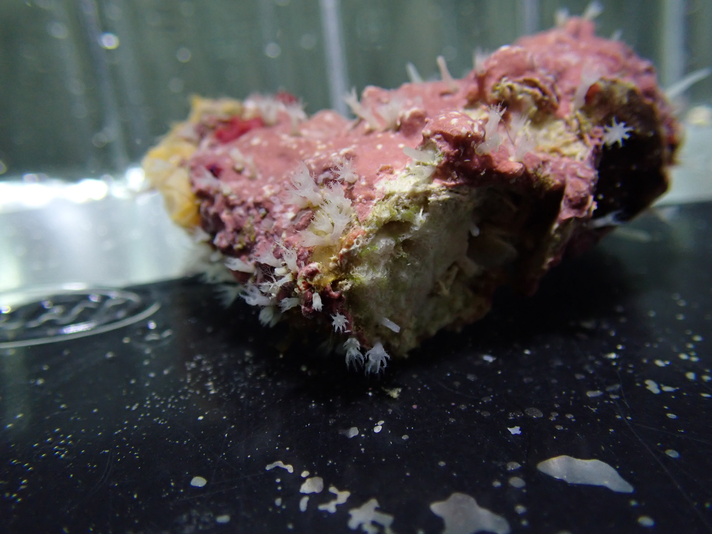
Scientific insights
Settlement is non-random
Substratum affects mortality
Point of contact matters
Octocoral polyps prefer CCA and avoid Ramicrusta. They show no preference or avoidance of bare surfaces.
Octocorals showed increased mortality on both CCA and Ramicrusta, despite showing preferences for CCA.
Point of direct contact matters more than surrounding habitat in settlement choice processes.

Slide 13
Future plans!
Main sticking points:
File structure & access
Deciding which area calculation method is best
Separating chunks in a reasonable way
Things I’ll do next time:
Include super clear descriptions for each line / task
Write style guide before and while coding
Never use Excel again

